Slide 1


Database management systems and applications laboratory Railway enquiry system mini project 2021-2022

Slide 2
TeaM MEMBERS 1. ANUSH RAJAGOPALAN -205002012 2. MAHALAKSHMI M – 205002046 3.Sai Shanmat-205002077

Slide 3
proBLEM STATEMENT
Design a database solution for the railway network. The enquiry system should have the following information:
Station names
Train IDs with names
Weekly Schedules of the trains
Ticket Availability
Cost of trip
The train schedules should have information on the stations from where the train starts and by when it reaches the destination. It should also include information about all stations it passes through during its journey.

Slide 4
REQUIREMENT ANALYSIS:
Given a route ID, we need to display the available trains, available routes, available stations that a train passes through.
REAL TIME APPLICATION:
In real time, we save the details of users, their booking requirements and also keep track of their past bookings, upcoming bookings, transaction history.

Slide 5
NORMALIZATION:
LOGINP={ USERNAME,PASSWORD }
1NF NOMALIZATION:
No Multivalued Attributes. So, there is no need to do 3NF
2NF NOMALIZATION:
There is no partial dependency. So, there is no need to do 2NF.
3NF NOMALIZATION:
There is no transitive dependency. So, there is no need to do 3NF.
ADMINCRD={ ID,PASSWRD }
1NF NOMALIZATION:
No Multivalued Attributes. So, there is no need to do 3NF
2NF NOMALIZATION:
There is no partial dependency. So, there is no need to do 2NF.
3NF NOMALIZATION:
There is no transitive dependency. So, there is no need to do 3NF.

Slide 6
STATION={ STATION_ID, ROUTE_ID,STATION_NAME } 1NF NOMALIZATION: No Multivalued Attributes. So, there is no need to do 3NF 2NF NOMALIZATION: There is no partial dependency. So, there is no need to do 2NF. 3NF NOMALIZATION: There is no transitive dependency. So, there is no need to do 3NF. ROUTE={ ROUTE_ID, ORIGIN,DESTINATION,DISTANCE,FARE } 1NF NOMALIZATION: No Multivalued Attributes. So, there is no need to do 3NF 2NF NOMALIZATION: There is no partial dependency. So, there is no need to do 2NF. 3NF NOMALIZATION: There is no transitive dependency. So, there is no need to do 3NF.

Slide 7
TRAIN = { TRAIN _NO,ROUTE_ID, TRAIN_NAME,DEP_TIME,ARR_TIME, ORIGIN,DESTINATION } 1NF NOMALIZATION: No Multivalued Attributes. So, there is no need to do 3NF 2NF NOMALIZATION: There is no partial dependency. So, there is no need to do 2NF. 3NF NOMALIZATION: There is no transitive dependency. So, there is no need to do 3NF.

Slide 8
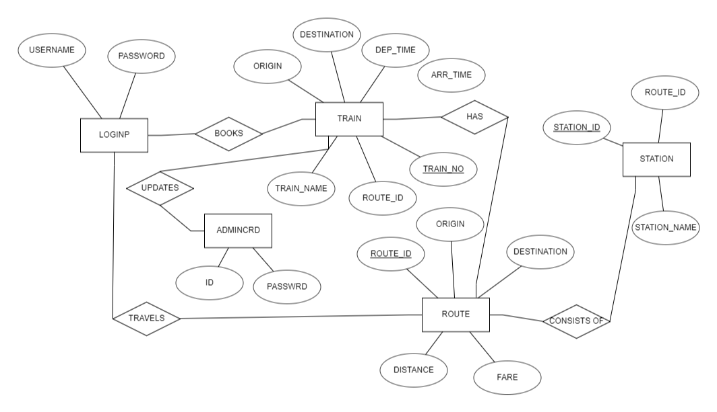
ER diagram

Slide 9
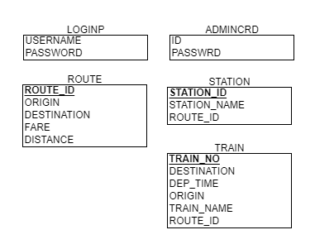
SCHEMA DIAGRAM:

Slide 10
Sql commands
ROUTE TABLE
CREATE TABLE ROUTE(
-> ROUTE_ID INT(5) PRIMARY KEY,
-> ORIGIN CHAR(20),
-> DESTINATION CHAR(20),
-> FARE INT(5),
-> DISTANCE INT(5));
+-------------+----------+------+-----+---------+-------+
| Field | Type | Null | Key | Default | Extra |
+-------------+----------+------+-----+---------+-------+
| ROUTE_ID | int | NO | PRI | NULL | |
| ORIGIN | char(20) | YES | | NULL | |
| DESTINATION | char(20) | YES | | NULL | |
| FARE | int | YES | | NULL | |
| DISTANCE | int | YES | | NULL | |
+-------------+----------+------+-----+---------+-------+

Slide 11
STATION TABLE: CREATE TABLE STATION ( -> ROUTE_ID INT(5), -> STATION_ID INT(5), -> STATION_NAME CHAR(20), -> FOREIGN KEY(ROUTE_ID) REFERENCES ROUTE(ROUTE_ID)); +--------------+----------+------+-----+---------+-------+ | Field | Type | Null | Key | Default | Extra | +--------------+----------+------+-----+---------+-------+ | ROUTE_ID | int | YES | MUL | NULL | | | STATION_ID | int | YES | | NULL | | | STATION_NAME | char(20) | YES | | NULL | | +--------------+----------+------+-----+---------+-------+

Slide 12
TRAIN TABLE: CREATE TABLE TRAIN( -> TRAIN_NO INT(10) PRIMARY KEY, -> ROUTE_ID INT(5), -> TRAIN_NAME CHAR(20), -> ORIGIN CHAR(20), -> DESTINATION CHAR(20), -> DEP_TIME CHAR(15), -> ARR_TIME CHAR(15), -> TRAVEL_DATE CHAR(15), -> CAPACITY INT(5), -> INDEX(ROUTE_ID), -> FOREIGN KEY(ROUTE_ID) REFERENCES ROUTE(ROUTE_ID)); +-------------+----------+------+-----+---------+-------+ | Field | Type | Null | Key | Default | Extra | +-------------+----------+------+-----+---------+-------+ | TRAIN_NO | int | NO | PRI | NULL | | | ROUTE_ID | int | YES | MUL | NULL | | | TRAIN_NAME | char(20) | YES | | NULL | | | ORIGIN | char(20) | YES | | NULL | | | DESTINATION | char(20) | YES | | NULL | | | DEP_TIME | char(15) | YES | | NULL | | | ARR_TIME | char(15) | YES | | NULL | | | TRAVEL_DATE | char(15) | YES | | NULL | | | CAPACITY | int | YES | | NULL | | +-------------+----------+------+-----+---------+-------+

Slide 13
PASSENGER LOGIN TABLE (LOGINP): CREATE TABLE LOGINP( -> USERNAME_CHAR(20), -> PASSWORD CHAR(20)); +----------+----------+------+-----+---------+-------+ | Field | Type | Null | Key | Default | Extra | +----------+----------+------+-----+---------+-------+ | USERNAME | char(20) | YES | | NULL | | | PASSWORD | char(20) | YES | | NULL | | +----------+----------+------+-----+---------+-------+

Slide 14
ADMIN LOGIN TABLE (ADMINCRD): CREATE TABLE ADMINCRD( -> ID_CHAR(20), -> PASSWRD CHAR(20)); +---------+----------+------+-----+---------+-------+ | Field | Type | Null | Key | Default | Extra | +---------+----------+------+-----+---------+-------+ | id | int | YES | | NULL | | | passwrd | char(30) | YES | | NULL | | +---------+----------+------+-----+---------+-------+

Slide 15
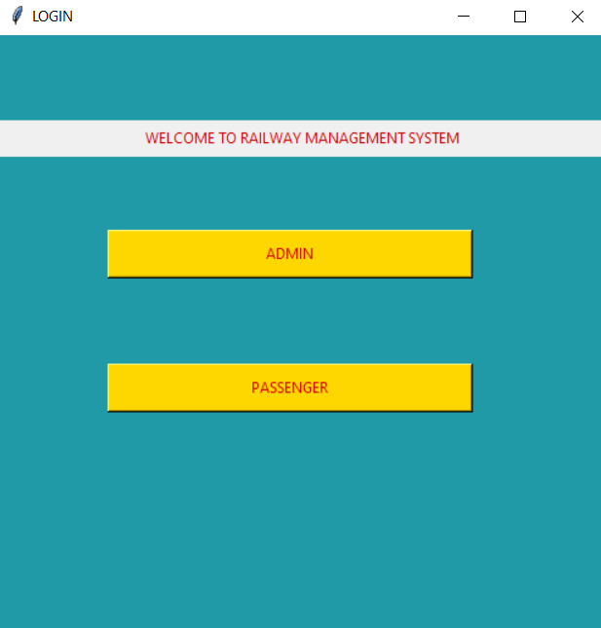
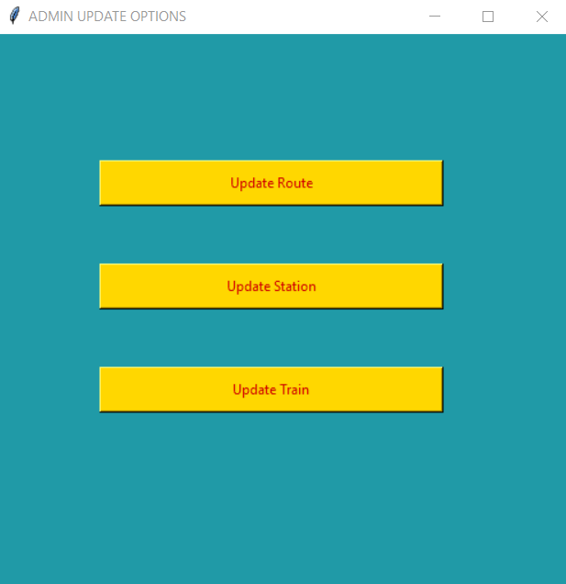
Output screenshots

Slide 16
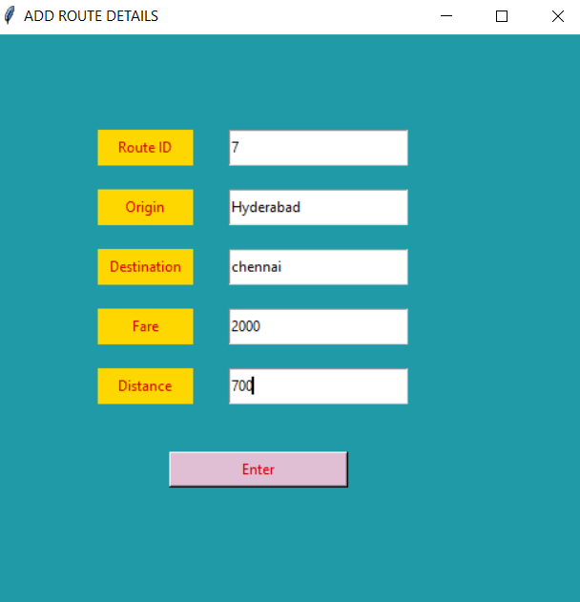
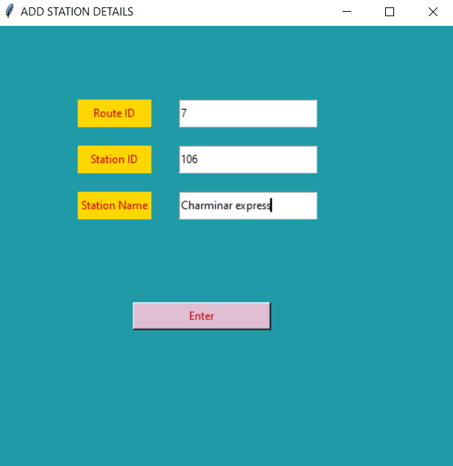

Slide 17
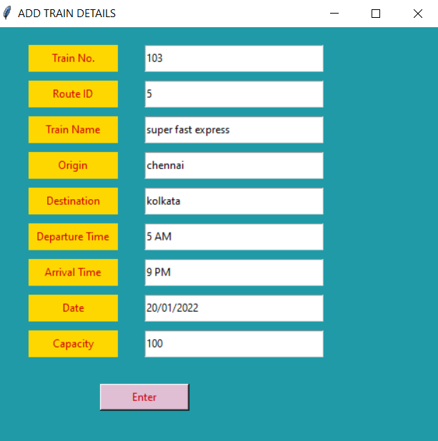
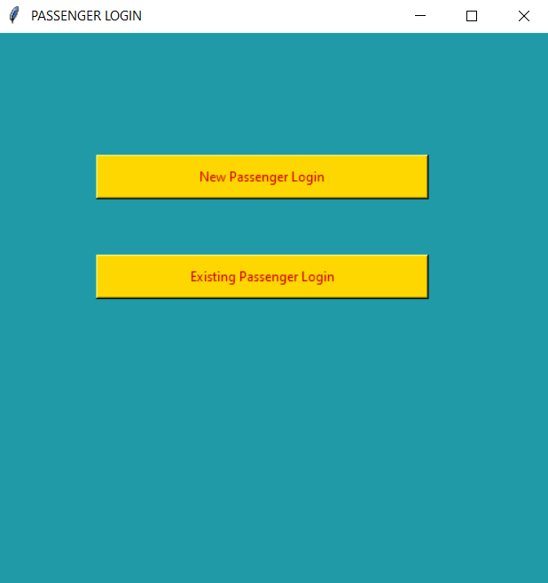

Slide 18
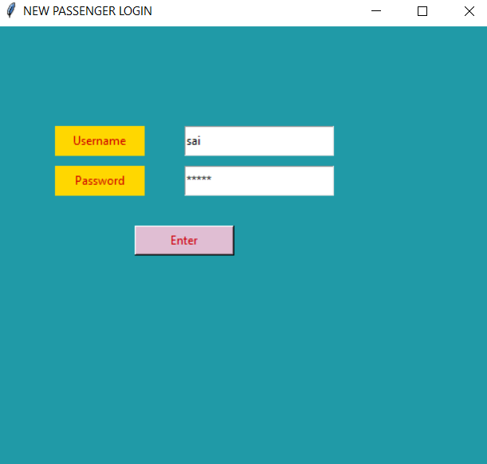
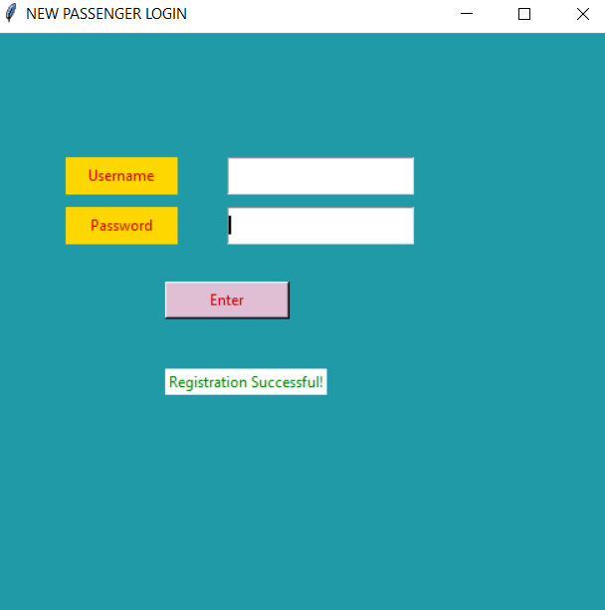

Slide 19
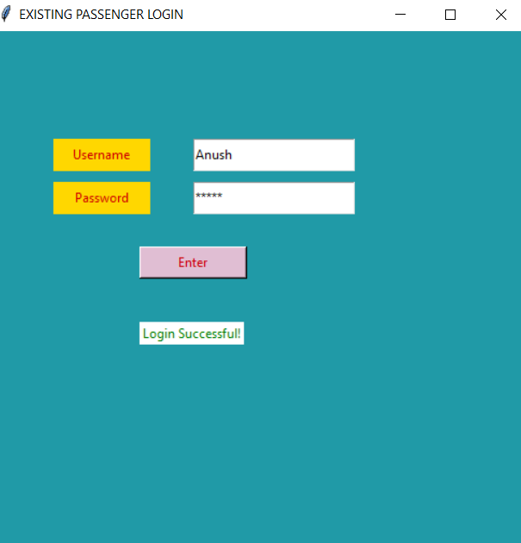
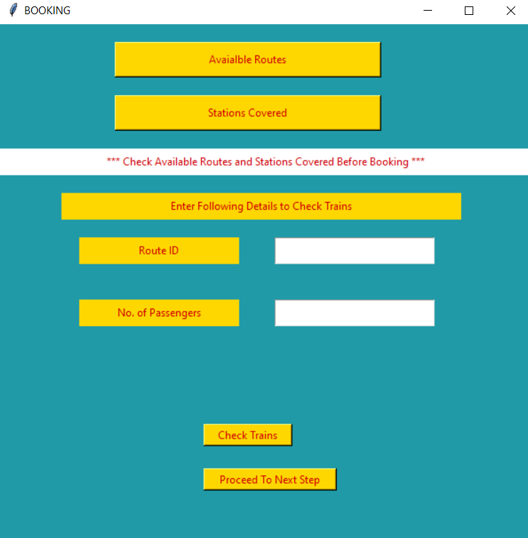

Slide 20
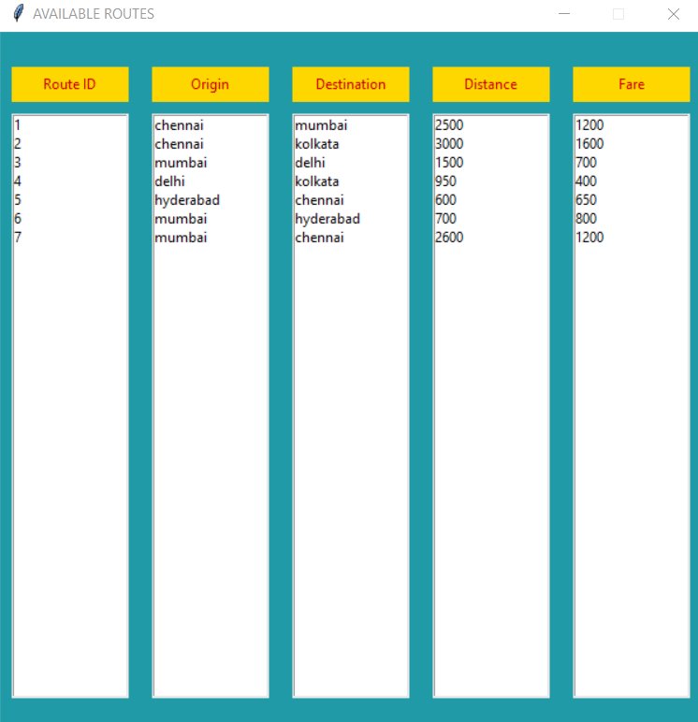
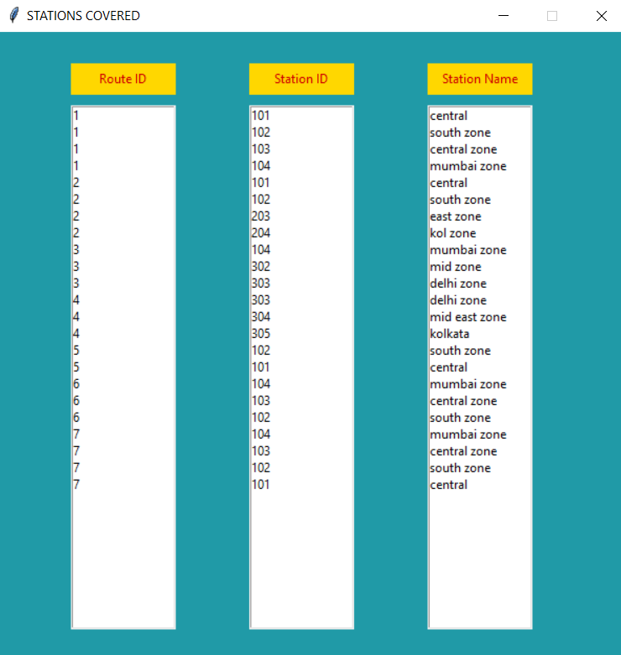

Slide 21
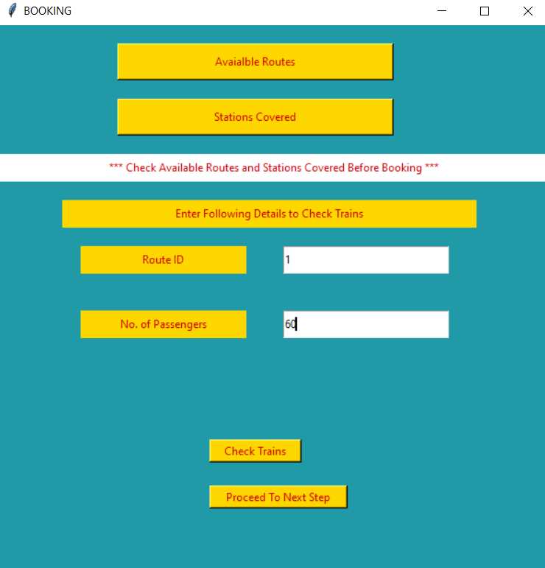

Slide 22
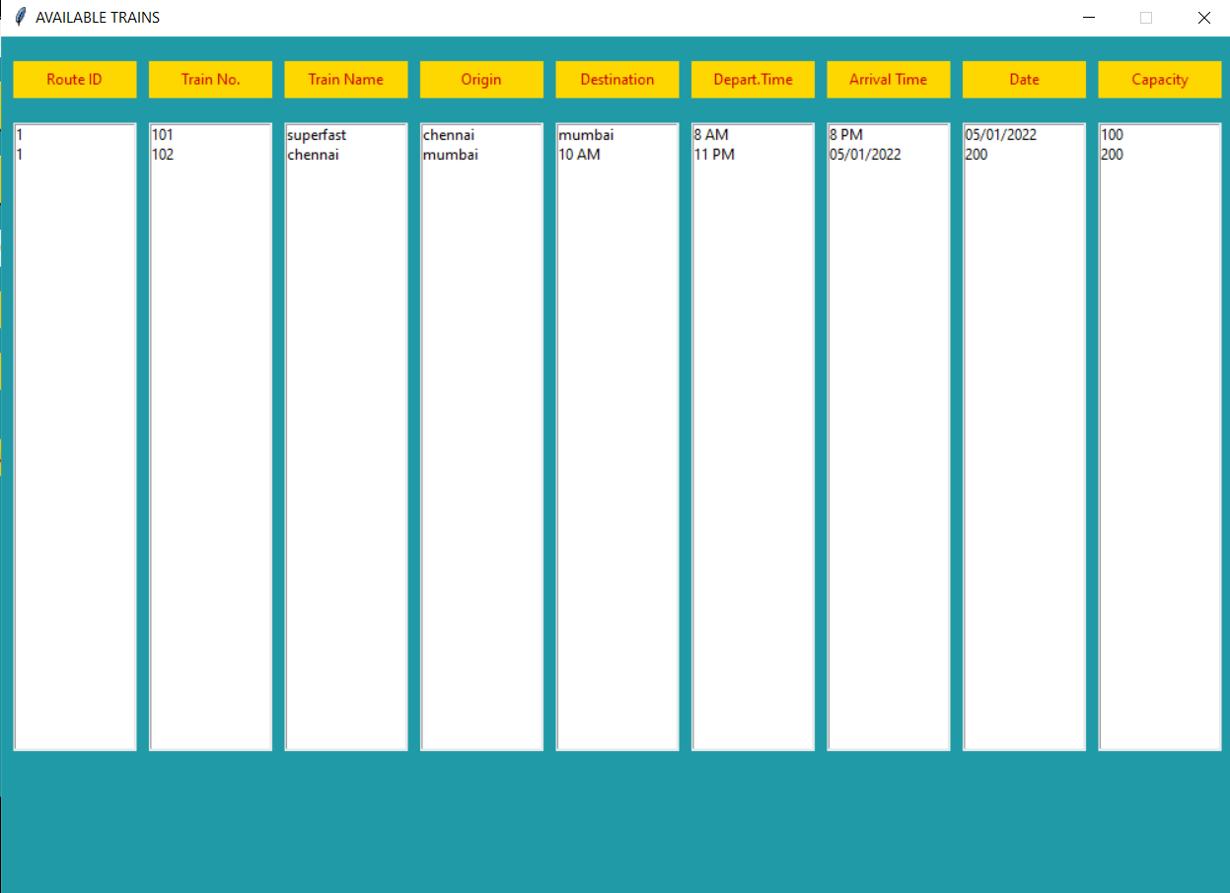

Slide 23
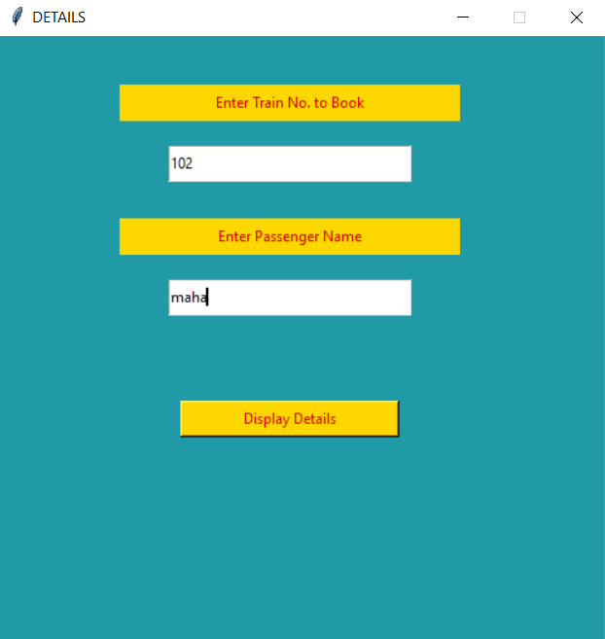
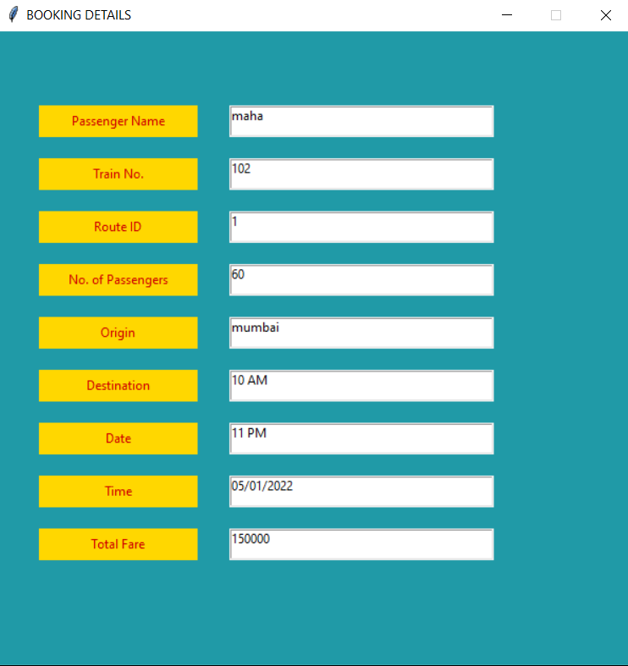

Slide 24
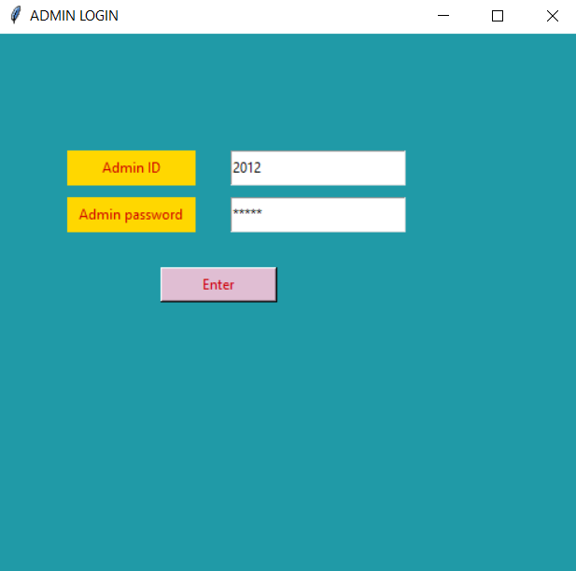
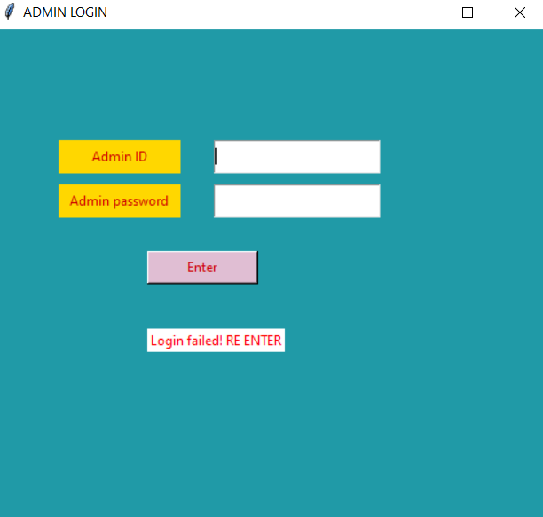

Slide 25
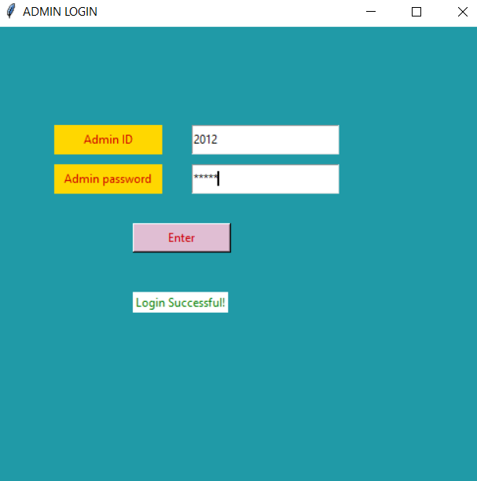

Slide 26
result
Thus, the required database has been designed and the appropriate data has been inserted, and GUI has been created

